Slide 1


Submitted By AMIT RANJAN KUMAR REGISTRATION NO: 310520631006
ROLE OF BRANDING & ADVERTISEMENT IN RETAIL MARKET OF STEEL INDUSTRIES
Under the Guidance of
Ms. G.Ragni
Assistant Professor(MBA)
Friday, September 1, 2023
DHANALAKSHMI SRINIVASAN COLLEGE OF ENGINEERING SND TECHNOLOGY
DEPARTENT OF MBA

Slide 2
ABSTRACT
The product has been formulated to study the marketing system of NATIONAL ENGG. WORKS.
At the present time of out throat competition every company wants to top the chart and show big figure of profits units balance
It is quite clear today that at present time. The growth of any organization is possible only with the help of harp working and well focused staff.
The market want to analyses the consumer behavior of Steel segment of NATIONAL ENGG.WORK group and all the leading techniques to be lead for market. Providing better service to the customer, according to their Needs
Friday, September 1, 2023
DHANALAKSHMI SRINIVASAN COLLEGE OF ENGINEERING SND TECHNOLOGY
DEPARTENT OF MBA

Slide 3
COMPANY PROFILE
The NATIONAL ENGG.WORKS GROUP was founded in 1969 by brother's Shri Shashi Ruia and Ravi Ruia
The Ruia family, s origins are in Rajasthan. Something in the 19th century it moved to Mumbai and set up its own business .In 1956 ,Shri Nandkishore Ruia ,father to Shri shay Ruia and Ravi Ruia moved to Chennai of the south Indian state of Tamil Nandu ,to begin two independent business activities. He mentored his sons in the intricacies of business. Wl %44 shri Nandkishor Ruia passed away in 1969, the brothers laid the foundation of the grow
The NATIONAL ENGG. WORKS group began its operations with the construction of an outer break water in ft4 Chennai port. It quickly moved to cApitalise on every emerging business opportunity become Indian's first private company to buy a tanker in 1976.The group also invest in a diverse shipping fleet and oil rigs, when government of India opened up the shippi and drilling business to private players in the 1960
.
.
Friday, September 1, 2023
DHANALAKSHMI SRINIVASAN COLLEGE OF ENGINEERING SND TECHNOLOGY
DEPARTENT OF CSE

Slide 4
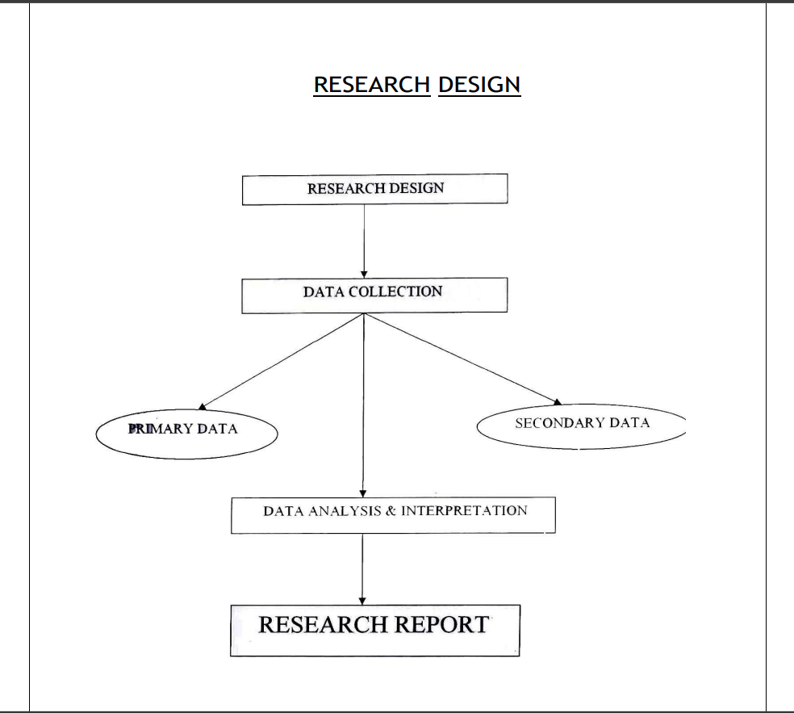
FLOWCHART
Friday, September 1, 2023
DHANALAKSHMI SRINIVASAN COLLEGE OF ENGINEERING SND TECHNOLOGY
DEPARTENT OF CSE

Slide 5
RESEARCH PROCESS
The first stage of marketing research calls for developing the most efficient plan for getting need to know the cost of the research plan before approving it. Design research approaches instrument and sampling plan.
DATA ROURCE :The research can gather secondary data primary data both.
PRIMARY DATA: Primary data are gathered for specific purpose or for a specific research project. It is very important to know that when the needed data do exit or are dated inaccurate or unreliable the researcher will have to collect Primary data. Most marketing research project involves some Primary data collection.
SECONDARY DATA: Secondary data are data that were collected for another purpose and already somewhere. Researcher usually starts their investigation by examining Secondary data to see whether their problems can bepartly or wholly solved without collection costly primary data. I this project I have collected primary & secondary data
Friday, September 1, 2023
DHANALAKSHMI SRINIVASAN COLLEGE OF ENGINEERING SND TECHNOLOGY
DEPARTENT OF CSE

Slide 6
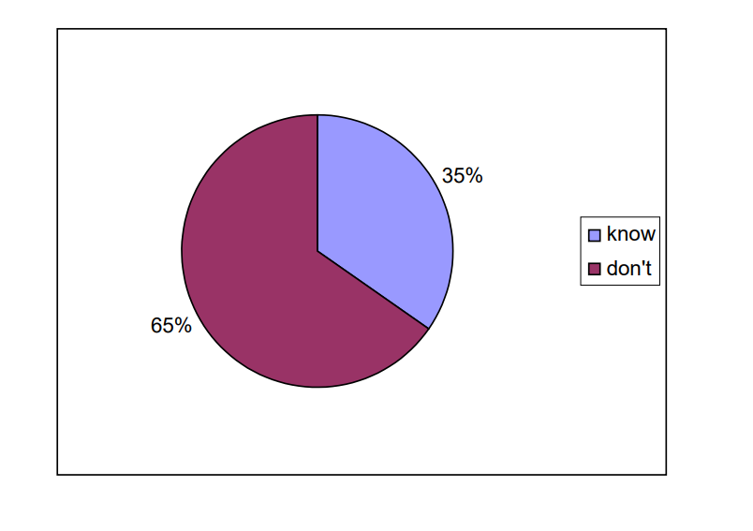
DATA ANALYSIS AND INTERPRETATION
1..Do you know about the Essar steel? 68
Yes 35.2%
No. 65.8%
Friday, September 1, 2023
DHANALAKSHMI SRINIVASAN COLLEGE OF ENGINEERING SND TECHNOLOGY
DEPARTENT OF CSE

Slide 7
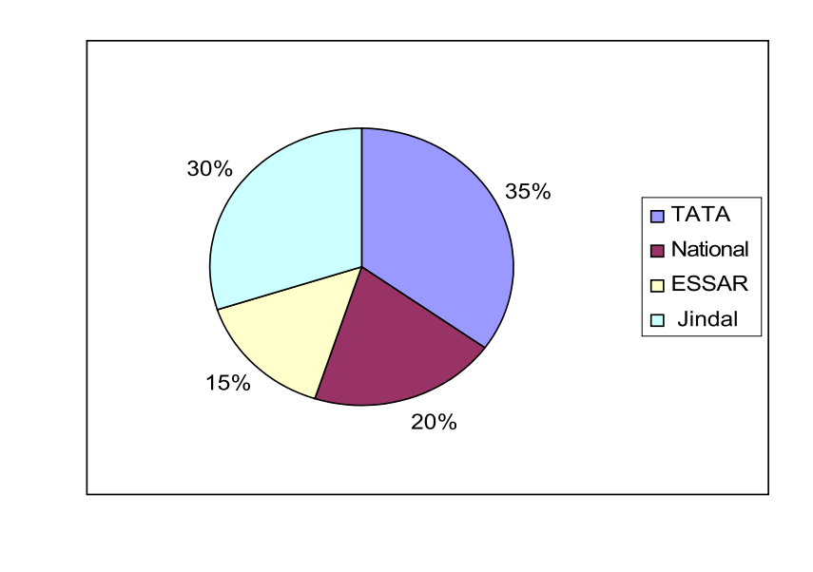
DATA ANALYSIS
2..Who according to you are the major competitors operating in your area?
35% TATA
20% National
15% ESSAR 30% Jindal
Friday, September 1, 2023
DHANALAKSHMI SRINIVASAN COLLEGE OF ENGINEERING SND TECHNOLOGY
DEPARTENT OF CSE

Slide 8
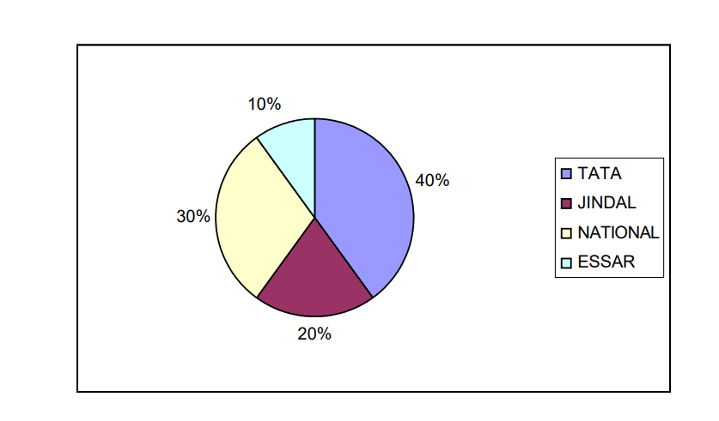
DATA ANALYSIS
3. Which company’s product you are using right now?
40% Use Tata GC sheet
20% use Jindal GC Sheet
30% use National GC Sheet
10% use Essar GC Sheet
Friday, September 1, 2023
DHANALAKSHMI SRINIVASAN COLLEGE OF ENGINEERING SND TECHNOLOGY
DEPARTENT OF CSE

Slide 9
MODULE
Pandas. Pandas is a Python module that is used for data manipulation and analysis.
Scikit-learn. Scikit-learn is a Python module that is used for machine learning.
Imbalanced-learn. Imbalanced-learn is a Python module that is used for dealing with imbalanced data.
Matplotlib. Matplotlib is a Python module that is used for creating visualizations.
NumPy. NumPy is a Python module that is used for scientific computing.
Friday, September 1, 2023
DHANALAKSHMI SRINIVASAN COLLEGE OF ENGINEERING SND TECHNOLOGY
DEPARTENT OF CSE

Slide 10
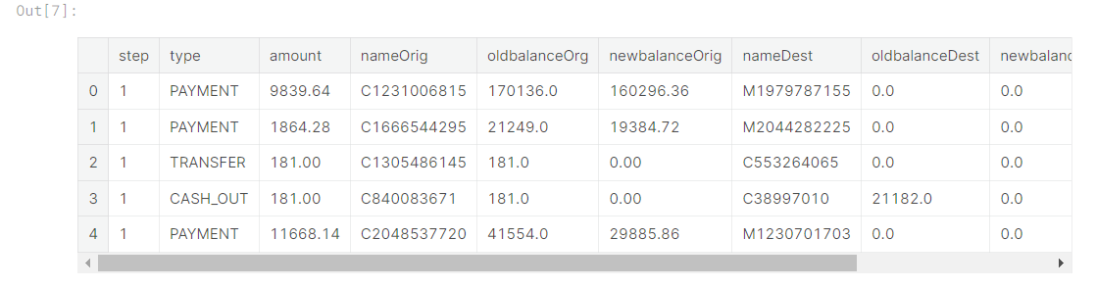
OUTPUT
Friday, September 1, 2023
DHANALAKSHMI SRINIVASAN COLLEGE OF ENGINEERING SND TECHNOLOGY
DEPARTENT OF CSE

Slide 11
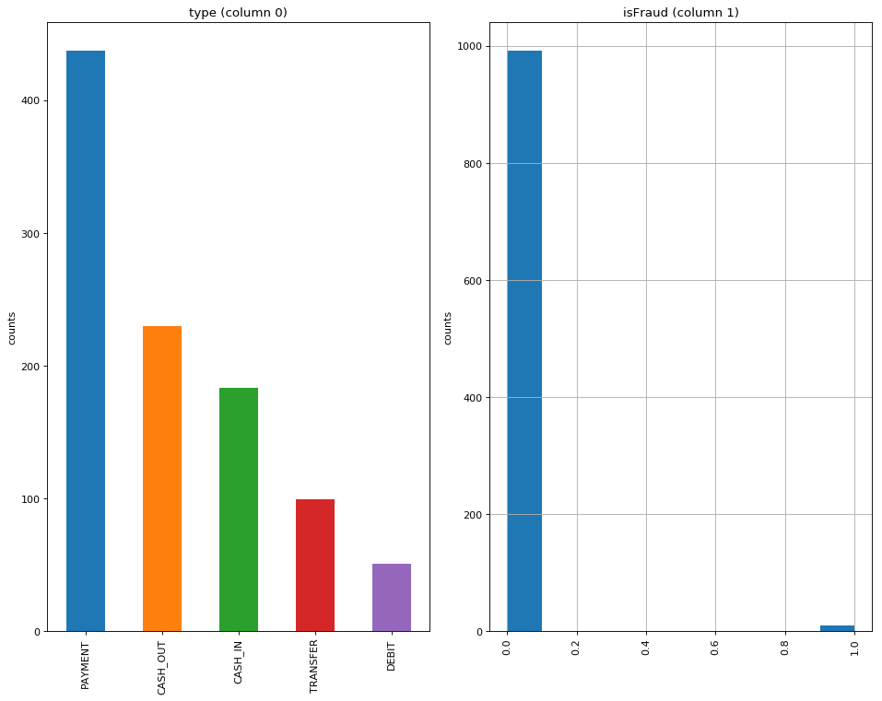
OUTPUT
Friday, September 1, 2023
DHANALAKSHMI SRINIVASAN COLLEGE OF ENGINEERING SND TECHNOLOGY
DEPARTENT OF CSE

Slide 12
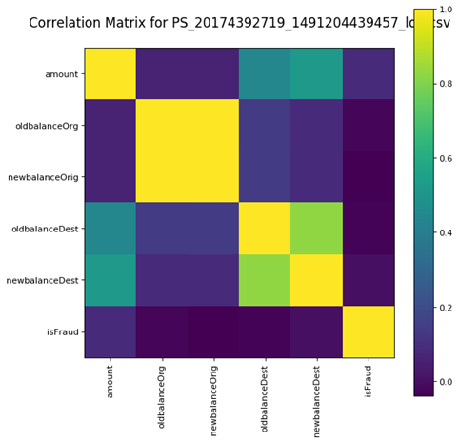
OUTPUT
Friday, September 1, 2023
DHANALAKSHMI SRINIVASAN COLLEGE OF ENGINEERING SND TECHNOLOGY
DEPARTENT OF CSE

Slide 13
CONCLUSION
During the project, I found that marketing research is the not an easy task It needs hard work and proper guidance. I have found so much information about G C Sheets in Retail any office. I found that there is no awareness among the customer in rural are only
❖ 35% customer aware
❖ 65% not aware.
Customer using the GC sheet right now
❖ 40% Tata
❖ 20% Jindal
❖30% National only
❖ 10% Essar
Factor behind the decline of sales
❖ Low advertisement
❖ Low awareness
The brand image of Essar steel is not very good in the eyes of customer. I rural areas people are not aware the-Essar steel.
Friday, September 1, 2023
DHANALAKSHMI SRINIVASAN COLLEGE OF ENGINEERING SND TECHNOLOGY
DEPARTENT OF CSE

Slide 14
REFERENCES
A Survey on Financial Fraud Detection Using Machine Learning by Chaudhary (2019)
Financial Fraud Detection Based on Machine Learning: A Systematic Literature Review by Lowell (2020)
The State of Financial Fraud Detection in 2023 by the Association of Certified Fraud Examiners (ACFE)
Financial Fraud Detection: A Practical Guide by the Federal Trade Commission (FTC)
Friday, September 1, 2023
DHANALAKSHMI SRINIVASAN COLLEGE OF ENGINEERING SND TECHNOLOGY
DEPARTENT OF CSE

Slide 15

Friday, September 1, 2023
DHANALAKSHMI SRINIVASAN COLLEGE OF ENGINEERING SND TECHNOLOGY
DEPARTENT OF CSE

